Slide 1

Applying the industry standard
Melissa Harrison
JATS4r Chair

Slide 2
Journal article publishing - online
Peer review
Accepted
Published
Publication
Conversion and author proofing
Editorial process
Author submits manuscript
Editor and reviewers Publisher arranges peer review
Production process
Copy editing
Conversion process
Quality Control
Online host and Indexing and archiving
Article made available via journal website
Metadata and full text sent elsewhere
https://jats4r.org/

Slide 3
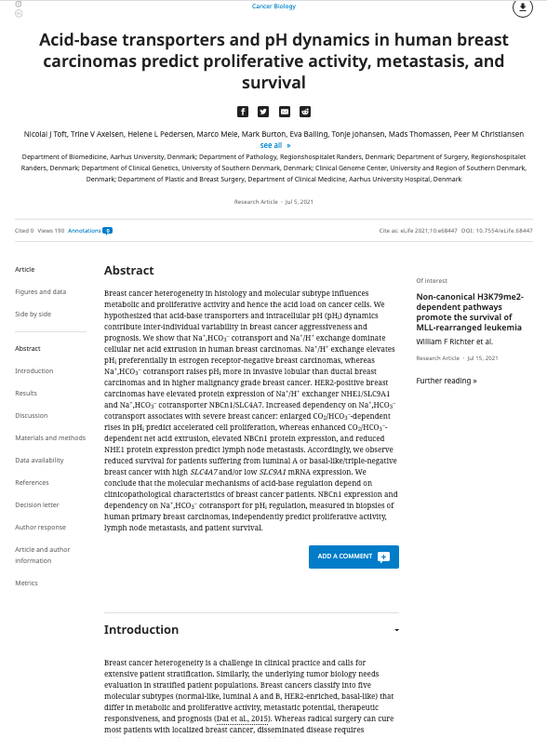

Production process
Typesetting – PDF and Full text version online
XML can drive both these processes
https://jats4r.org/

Slide 4
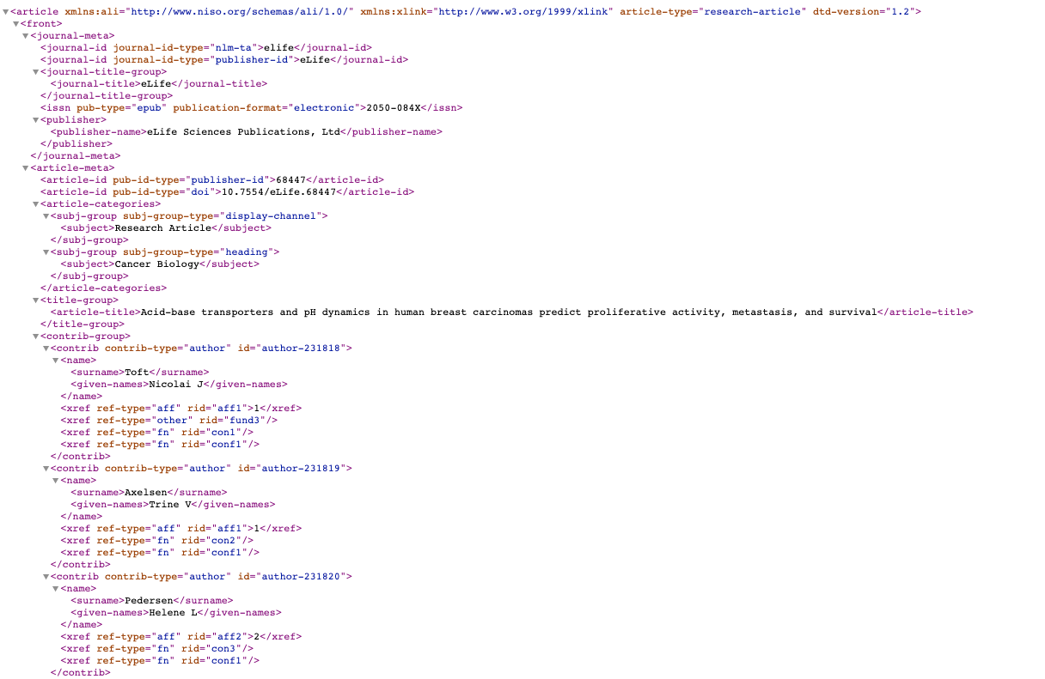
XML
Extensible Markup Language
Defines a set of rules for encoding documents in a format that is both human-readable and machine-readable
Provides a standard method to
  access information
  making it easier for applications and devices of all kinds to
    Use
    Store
    Transmit
    Display
https://jats4r.org/

Slide 5
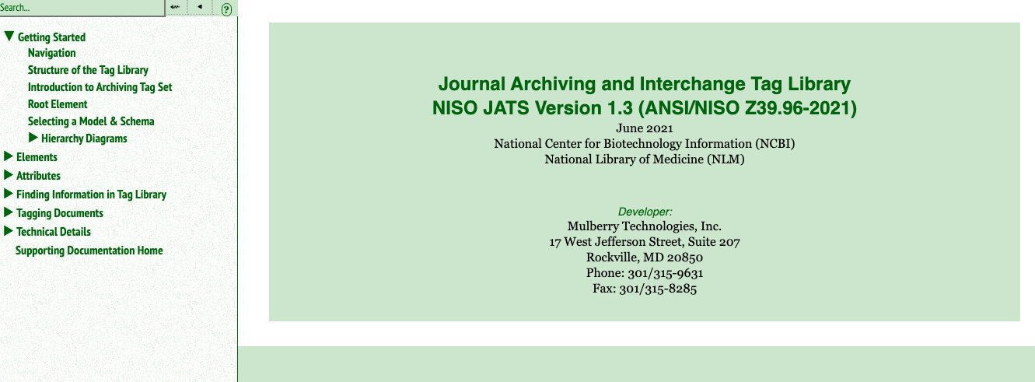
JATS
Document type definition (DTD)
  Set of rules and tags
Industry standard for publishing journal articles
ANSI/NISO Standard
Must support all publishers so needs to be “lose”
https://jats4r.org/

Slide 6
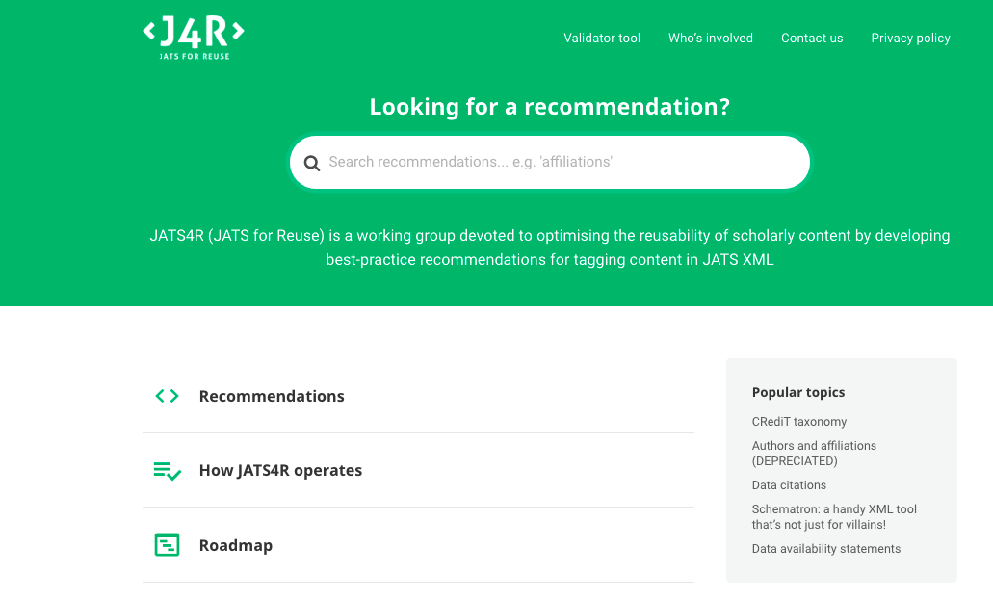
JATS4R
NISO Recommended Practice
Builds on JATS – tighter guidance on how to tag
https://jats4r.org/

Slide 7











Who contributes to JATS4R?
Steering Committee
Melissa Harrison (eLife); Jeff Beck (NCBI); Aradhana Mistry (BMJ); Stephen Laverick (Green Fifteen Publishing Consultancy); Kevin Lawson (KnowledgeWorks Global Ltd); Nick Nunes (HighWire Press)
Examples of subgroup organization contributions

Slide 8
What’s the point of JATS4R?
Six most time consuming task for data scientists
60% cleaning and organizing
19% collecting the data
Source: https://analyticsindiamag.com/6-tasks-data-scientists-spend-the-most-time-doing/
https://jats4r.org/

Slide 9

Why does this matter?
You don’t want your journal to live in a vacuum
  Discovery
  Meta analysis of content
  Open science initiatives
https://jats4r.org/

Slide 10
Thank you
Email: info@jats4r.org
Website: https://jats4r.org/
https://jats4r.org/

